Slide 1
INTRODUCTION TO DATA SCIENCE
PROJECT
Data Set
Google Play store
Team Members
Amrutha
USN: PES1201700829
Krithika
USN:PES1201701369

Slide 2
Contents
Overview of dataset
Data cleaning
Data visualisation
Hypothesis Testing
Correlation

Slide 3
Overview of Dataset
The Dataset that we have chosen is
‘Google Playstore’.
The Dataset implies the statistics of attributes such as category, no of installs,price,ratings,reviews etc.
This dataset contains 13 columns and about 10,000 rows.
8 Categorical Columns
5 Numerical Columns
The Dataset consisted of null values in both categorical and numerical columns.

Slide 4
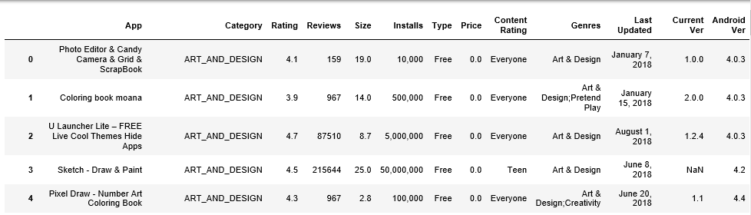
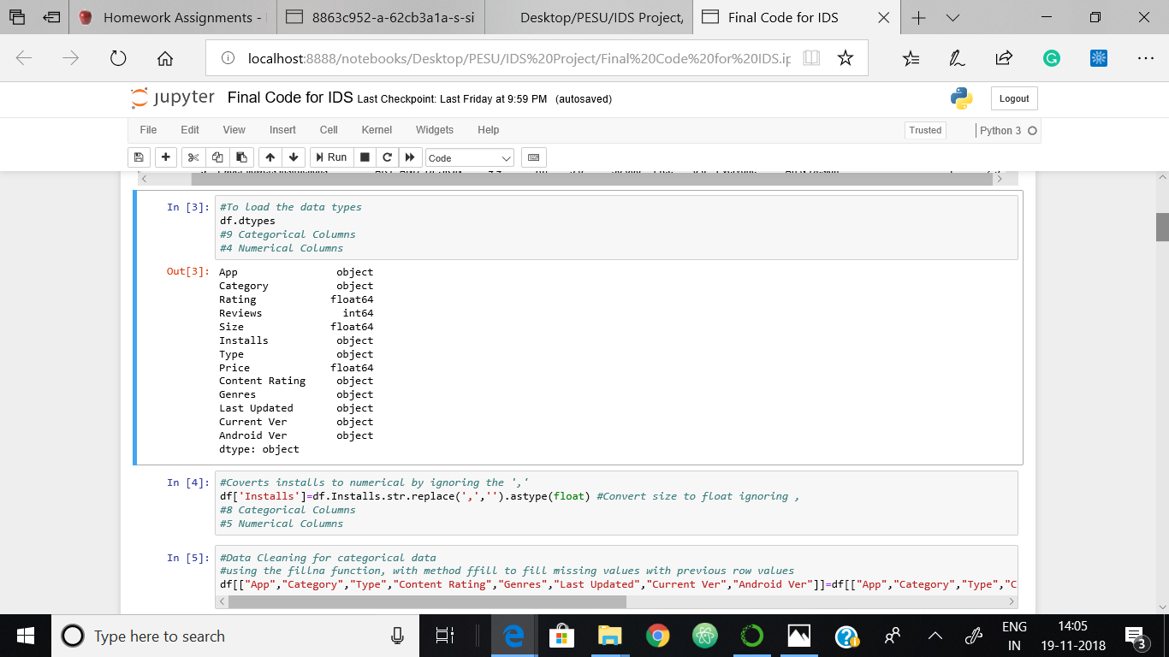

Slide 5
Data Cleaning
Data Cleaning is a very important step in Data Science to get accurate results as the presence of NaN values will create disturbances in the further calculations.
The categorical Columns with data as “NaN” is replaced with the data in the previous row.
Whereas the numerical Columns with data “NaN” is replaced with mean of the entire row.
Therefore the data is cleaned and ready for further calculations.
Columns with missing values:
Rating,Size,Type,Current Ver,Android Ver.

Slide 6
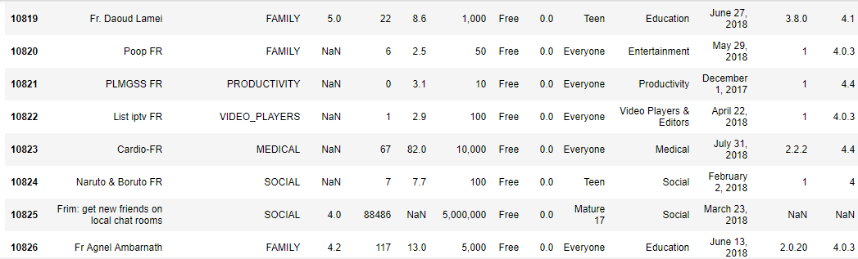
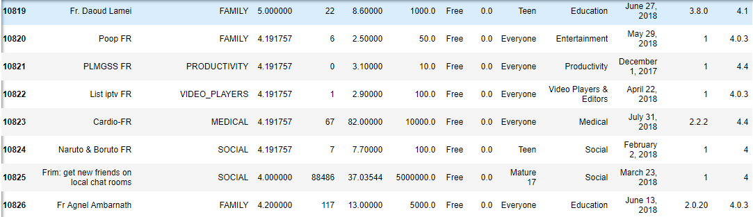
Before and after cleaning the dataset

Slide 7
Data visualisation
Data Visualization is an integral part of statistics.
It is one of the efficient and simple methods to draw insights regarding the dataset.
We have interpreted the dataset with different types of graphs comparing various primary key factors.
We have used plotlib and seaborn modules for the plotting of graphs.

Slide 8
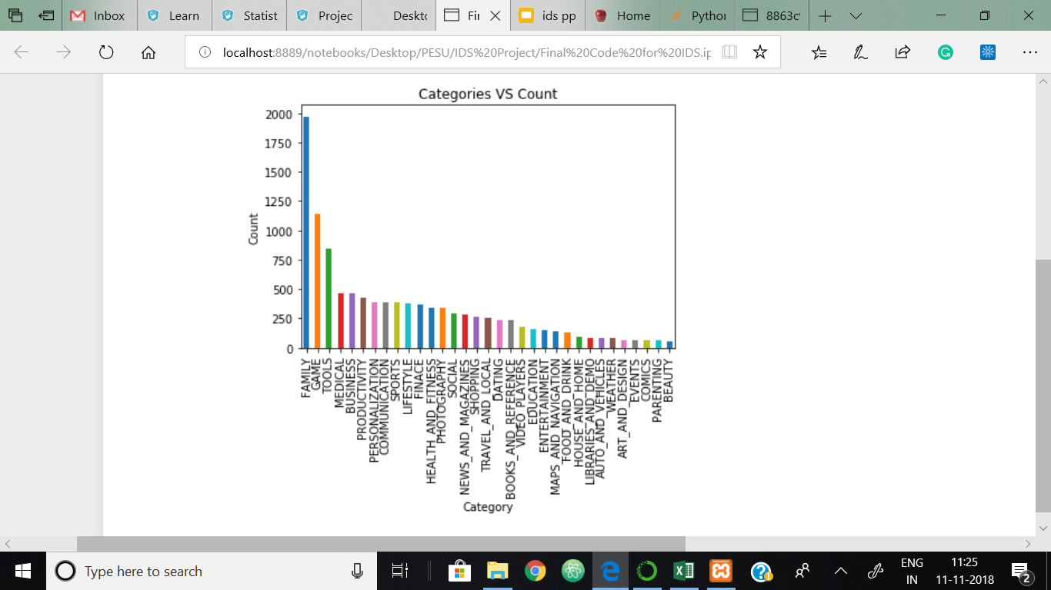
Bar graph representing the total number of apps for each category

Slide 9
Insights
This graph depicts the no of apps of different categories present in the playstore.
We Can infer that:
Majority of apps that are available on google playstore are of category ‘Family’ to attract greater audience.
There are comparatively very few number of apps related to Beauty , Comics, parenting, events and art and design.
Since the data set has many number of categories, two categories are further compared exclusively.

Slide 10
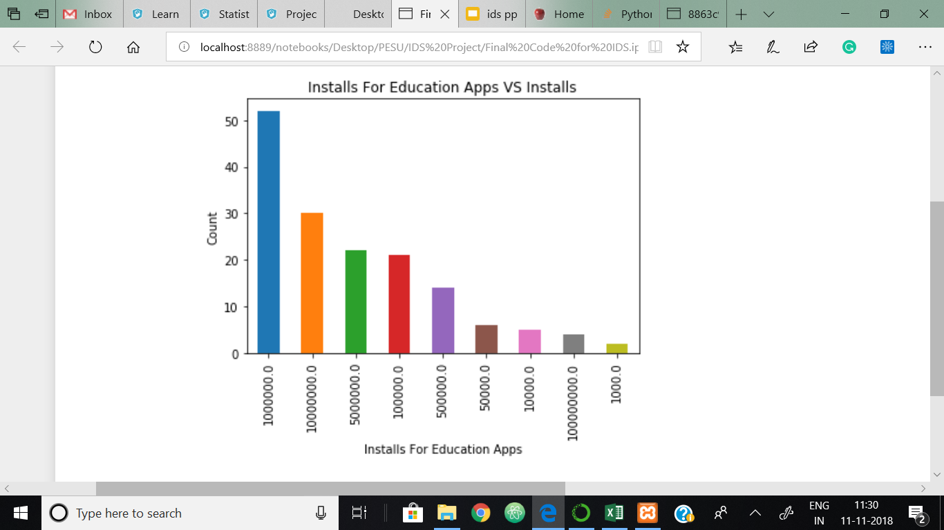
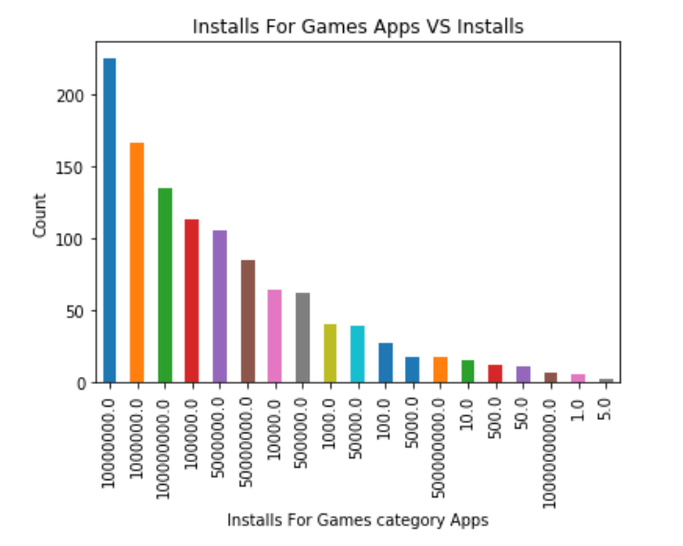
Installs of Education Apps VS Games Apps

Slide 11
Insights
The above two graphs depicts the no of installs with respect to category.
We can infer that :
No of installs of Games app is more than the No of installs of Education which represents the pattern of the users,“Games before Education”.
In the Education installs graph,we can infer that the educational apps have about 50 apps with maximum of 100000 installs.
Whereas the games apps have about 200 apps with maximum of 10000000 Installs.

Slide 12
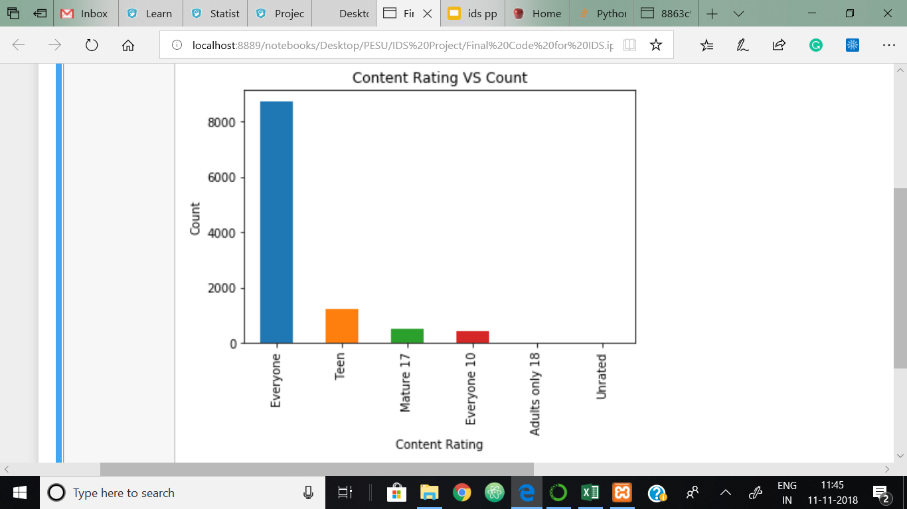
Bar graph of count of apps versus content rating

Slide 13
Insights
The above graph depicts apps according to the content ratings based on age groups.
We can infer that:
Most of the apps on google playstore are used those which do not have age restrictions and can be used by everyone.
There are hardly few apps that is restricted to adults (18+) and are unrated.
Therefore we can conclude that google play store have most of their apps which are user content friendly

Slide 14
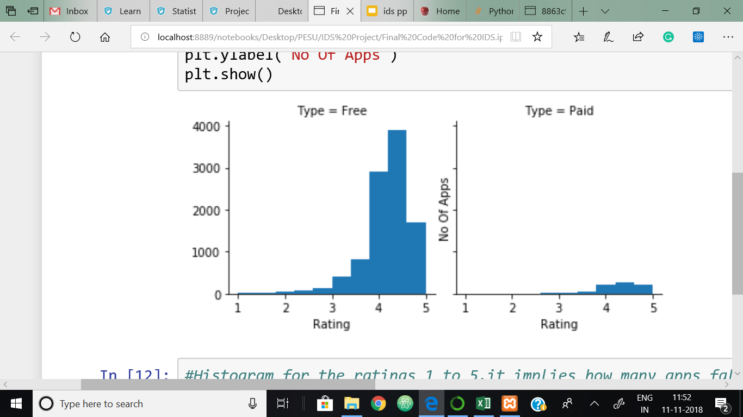
Bar plot representing overall ratings for Free and paid apps
Insights:
These Graphs depicts the Installation of apps based on price being free or paid.
We can infer that:
There are very few paid apps which are rated between 4 to 5.
Whereas in the free apps more than 80% of the apps are rated between 4 to 5.
Therefore we can conclude that free apps are more likely to be used and rated by the users.

Slide 15
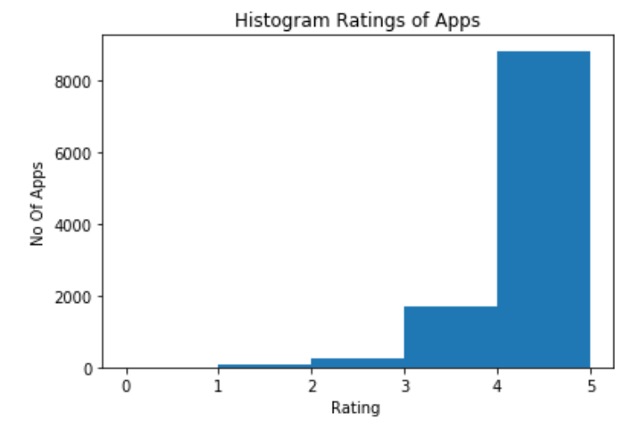
Histogram for Ratings of apps
The Graphs depicts the ratings of the app with respect to count.
This graphs represents no of apps with ratings 1 to 5 respectively.
We can infer that
There are a very few apps with rating less than 3.
Between 3 to 4 are a moderate amount of apps about 2000
Since there are more than 8000 apps with ratings from 4 to 5 we can conclude that most of the apps in google play store are well rated apps.

Slide 16
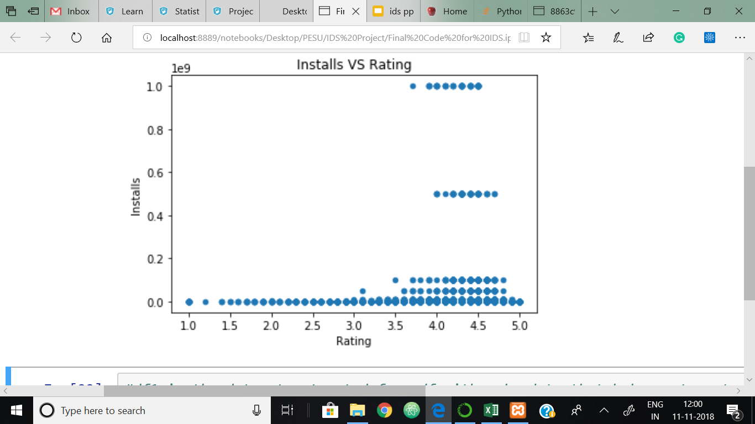
Scatter plot for number of installs against rating
The Graphs depicts the ratings for the apps with respect to the number of installs.
This graphs represents the pattern of the users that, the more the ratings on google play store the more the installs.
We can infer that
The apps with very less ratings are hardly installed.
And the apps with rating between 3.5 to 5 are installed in large numbers.

Slide 17
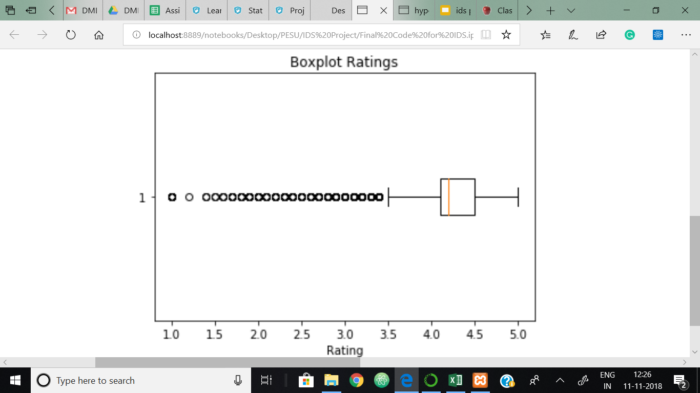
Box Plot for Rating
The Graphs depicts the box plot of ratings of apps.
We can infer that
It has outliers
Most of the apps have ratings in the range 3 to 5.
Values:
Max: 5.0
Min:3.5
Q1:4.0
Q3:4.5
Q2:4.2
IQR:0.5

Slide 18
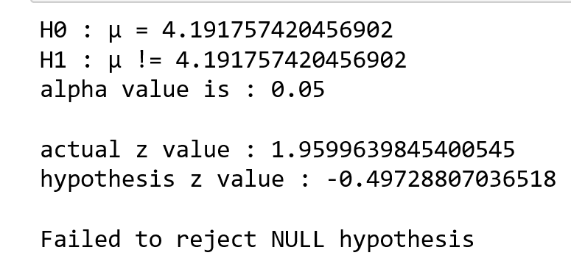
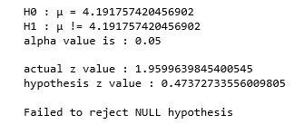
Hypothesis Testing

Slide 19
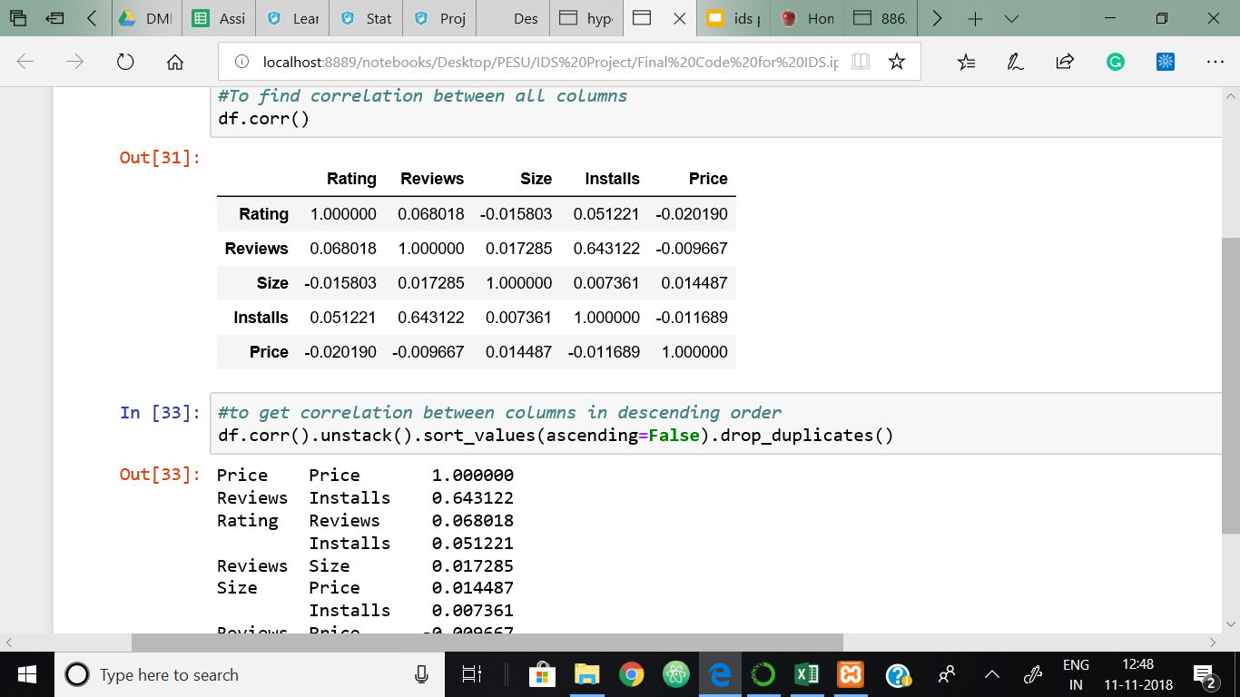
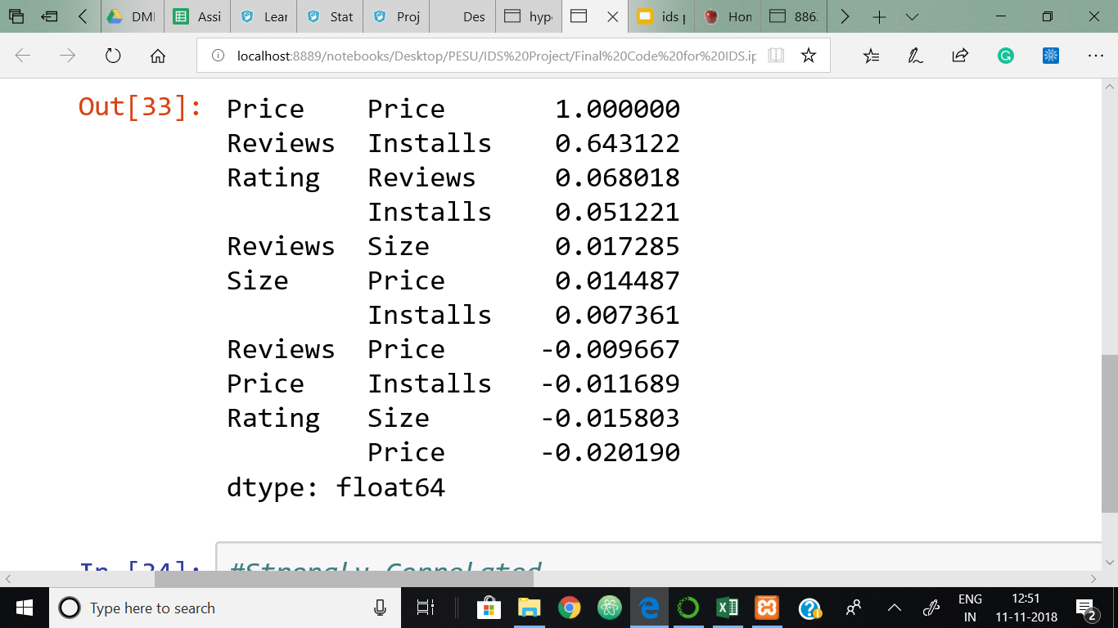
Correlation
To Find Correlation between all columns: df.corr()
To to get correlation between columns in descending order:
df.corr().unstack().sort_values(ascending=False).drop_duplicates()

Slide 20
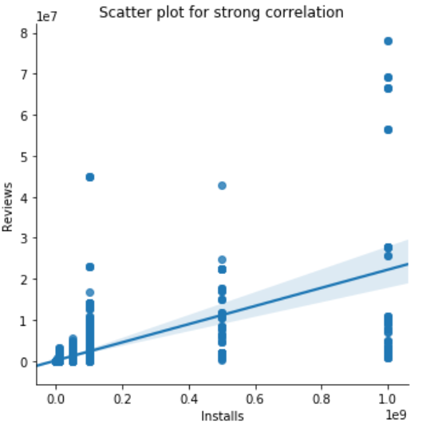
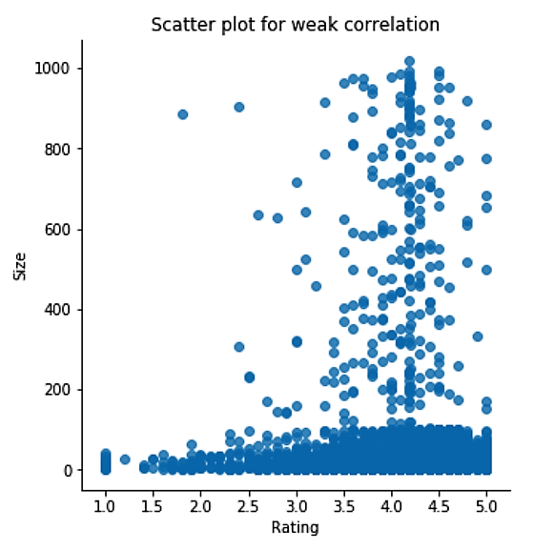
Insights and Graphs
From the above can infer that
Reviews and Installs are strongly correlated.
Ratings and Size are weakly correlated.

Slide 21
Thank You

